Slide 1
So You Want To Build A Data Science Program
Lessons Learned and Practical Advice For 2-Year Colleges

Slide 2
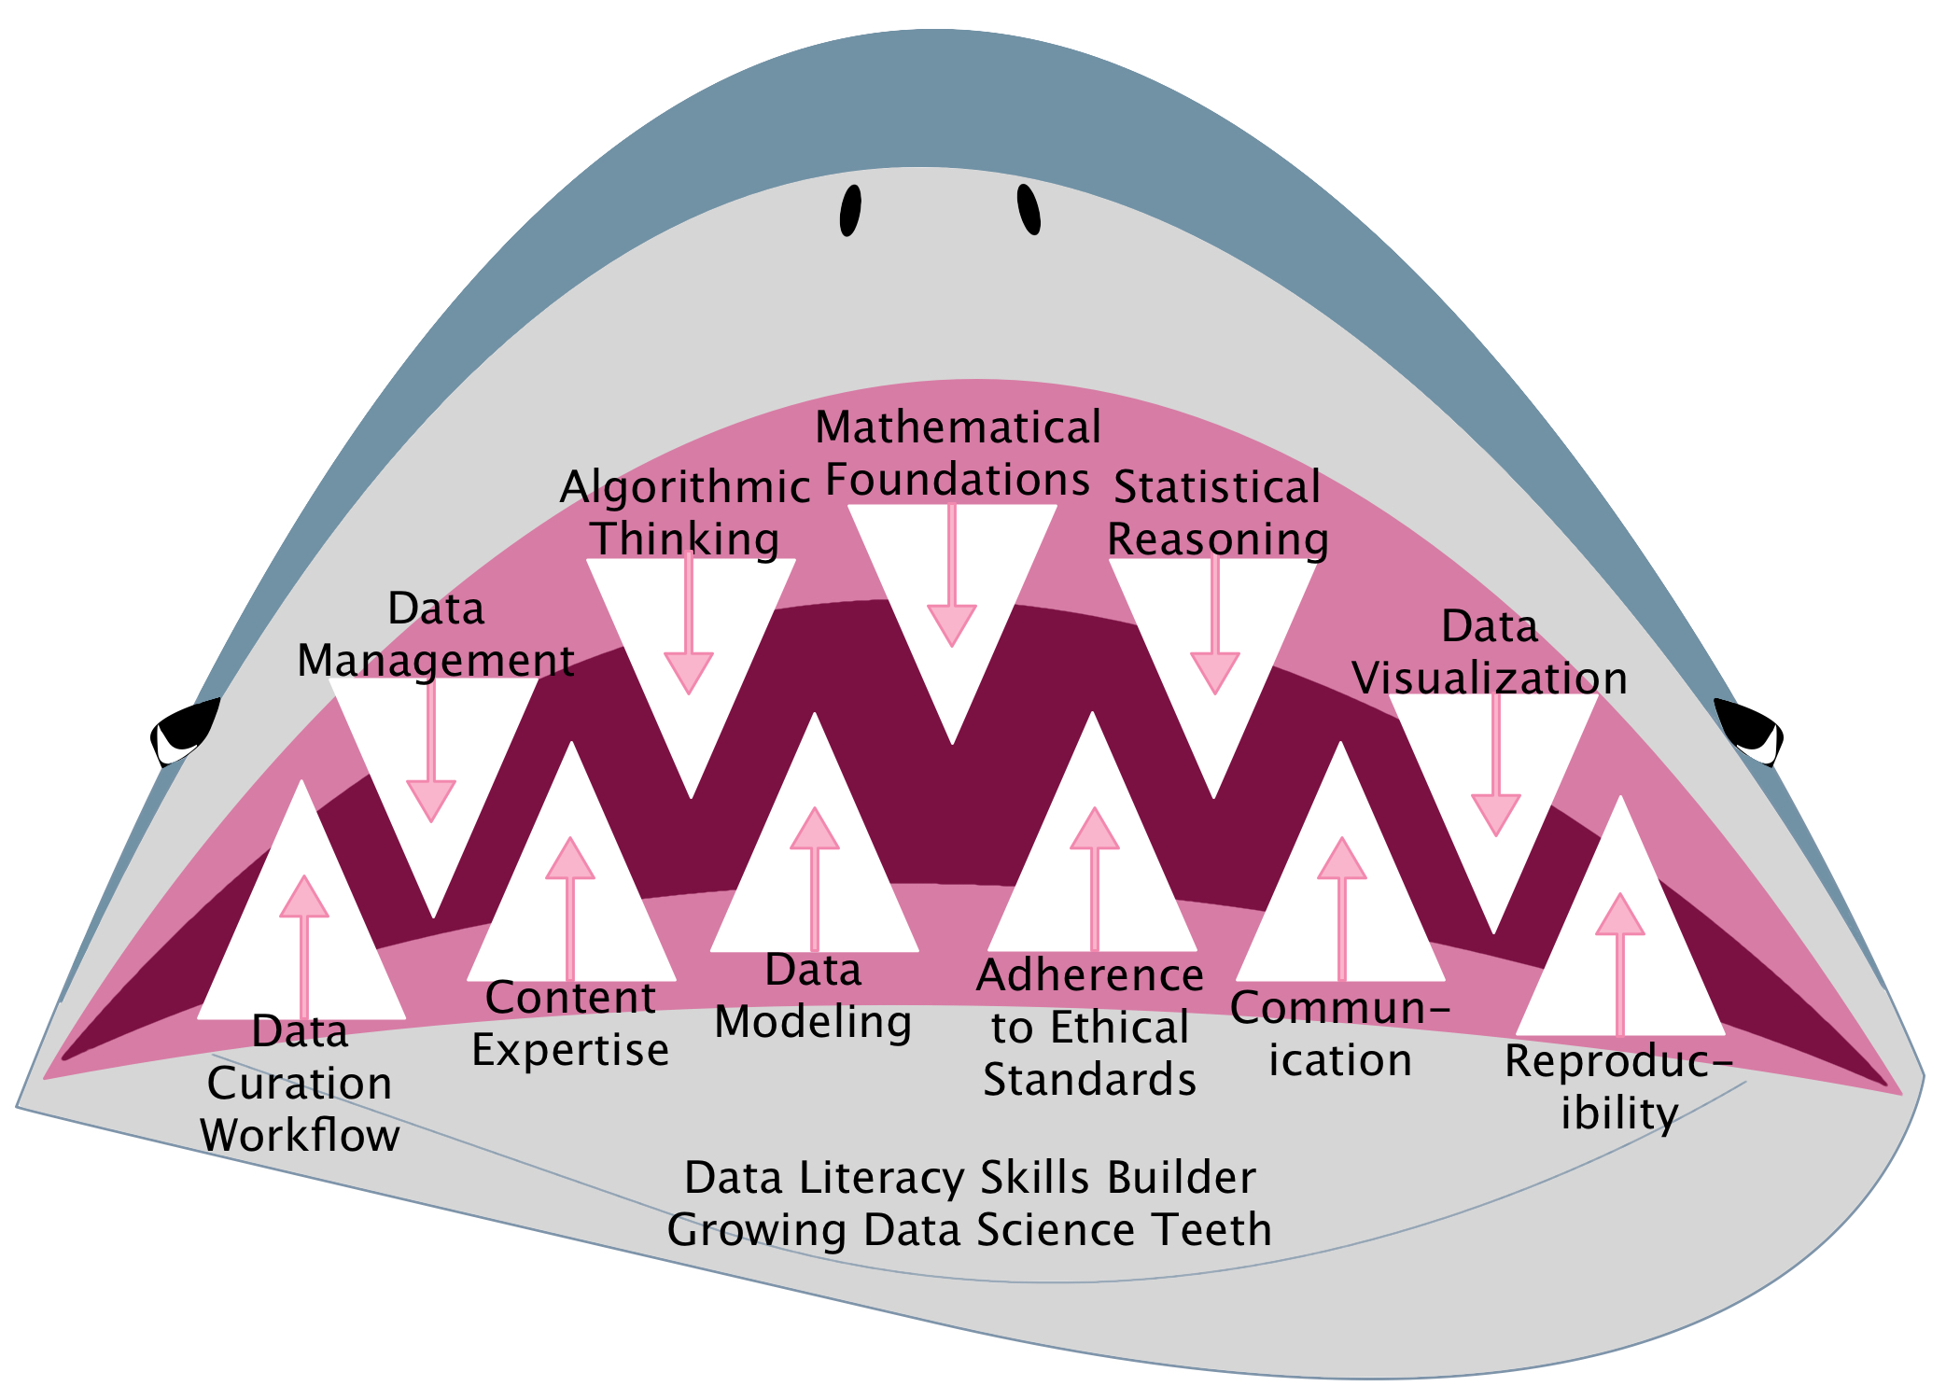
What Is Data Science?

Slide 3

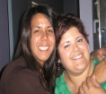

3
9
12
4
8
2
1
7
11
5
10
6
Notes:
Follow the journey, from “day one” to the current moment.

Slide 4

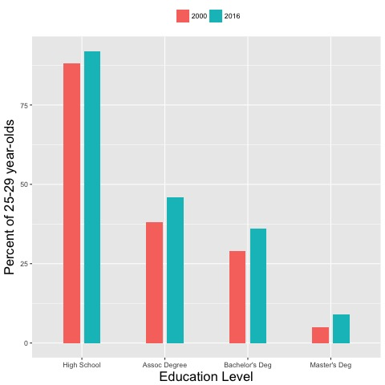
Day One – Ask Why?
Educational Attainment Overall
2017
Population 25-29 in age
Year 2000 on left
Year 2016 on right
High School Assoc Deg Bach Deg Masters Deg
Notes:
SOURCE: U.S. Department of Education, National Center for Education Statistics. (2017). The Condition of Education 2017 (NCES 2017-144), Educational Attainment of Young Adults
URL: https://nces.ed.gov/fastfacts/display.asp?id=27

Slide 5
3
9
12
4
8
2
7
11
5
10
6
Notes:
Follow the journey, from “day one” to the current moment.

Slide 6
Day Two – Ask Why?
Attended 2YC
Did not attend 2YC
Attended 2YC
Did not attend 2YC
Notes:
ª Hispanic may be any race. American Indian or Alaska Native, Asian, black or African American, Native Hawaiian or Other Pacific Islander, white, and more than one race refer to individuals who are not of Hispanic origin.
NOTES: Recent S&E degree recipients are those who earned their bachelor's or master's degrees between 1 July 2006 and 30 June 2011. Data are rounded to the nearest 1,000.
SOURCE: National Science Foundation, National Center for Science and Engineering Statistics, special tabulations (2015) of the 2013 National Survey of College Graduates.
Science and Engineering Indicators 2016

Slide 7
3
9
12
4
8
7
11
5
10
6
Notes:
Follow the journey, from “day one” to the current moment.

Slide 8
Day Three – Ask Why?
Attended 2YC
Did not attend 2YC
Notes:
NOTES: Recent S&E degree recipients are those who earned their bachelor's or master's degrees between 1 July 2006 and 30 June 2011. Data are rounded to the nearest 1,000.
SOURCE: National Science Foundation, National Center for Science and Engineering Statistics, special tabulations (2015) of the 2013 National Survey of College Graduates.
Science and Engineering Indicators 2016

Slide 9
9
12
4
8
7
11
5
10
6
Notes:
Follow the journey, from “day one” to the current moment.

Slide 10
Day Four – Ask Why?
First bullet point here
Second bullet point here
Third bullet point here
3/4 White
Notes:
NOTES: Includes only respondents to the community college question. Reporting categories for ethnicity and race were expanded in 2013; comparisons with prior-year data should be made with caution.
SOURCE: National Science Foundation, National Center for Science and Engineering Statistics, special tabulations (2014) of the 2013 Survey of Earned Doctorates.
Science and Engineering Indicators 2016

Slide 11
9
12
8
7
11
5
10
6
Notes:
Follow the journey, from “day one” to the current moment.

Slide 12
Day Five – Assess Current State
Current Student Interest
Faculty Expertise
Outside Interest
Potential Transfer Institutions
Potential Research/Internship Opportunities
Math Stats
Student Data
Expertise
CIS
Student Data
Expertise
Admin
Outside Data

Slide 13
9
12
8
7
11
10
6
Notes:
Follow the journey, from “day one” to the current moment.

Slide 14
Day Six – Get A Grant Innovation Fund Grant – CCSNH 2013
Create an undergraduate Certificate in Data Science
The objectives and goals
Support the needs of greater New England companies by providing a modern curriculum that will help local industries provide fundamental employee education in this critical, emerging area.
Provide a foundational set of coursework that students can apply immediately and slipstream into a four-year (or higher) data science/data analytics degree
Enhance existing computer science/computing resources with the modern data analytics and visualization tools
$10,000 was requested; $5,000 was granted
Notes:
The entire proposal as written can be provided upon request.

Slide 15
9
12
8
7
11
10
Notes:
Follow the journey, from “day one” to the current moment.

Slide 16
Day Seven Who’s Hiring? Results (2013-14)
Reach out to executives in industries like health care, insurance, financial services and scientific research – top industries in the greater Boston region
Reach out to the Data Science community at large
Reach out to institutions of higher education
Need is for highly skilled professionals with at least a Master’s Degree
Internships limited availability with more applicants than positions
UNH – Manchester - let’s talk about articulation

Slide 17
9
12
8
11
10
Notes:
Follow the journey, from “day one” to the current moment.

Slide 18
Day Eight – Certificate Development
MODEL A
Oceans of Data
MODEL B
Park City Math
Profile Of The Data Practitioner
April 2016
Colleges include: Bunker Hill (MA), Normandale (MN), Johnson County (KS), Sinclair (OH), Wake Tech (NC)
Data Science as a STEAM program
Lots of Math
Colleges of CCSNH: Manchester and Great Bay (NH)
Notes:
When we were working on our program at Great Bay, there was nothing available to help guide our thinking. Fortunately that is changing. Oceans of Data Institute: http://oceansofdata.org/our-work/profile-data-practitioner
Park City Math Institute (PCMI) published its curriculum guidelines in 2016: https://www.stat.berkeley.edu/~nolan/Papers/Data.Science.Guidelines.16.9.25.pdf

Slide 19
9
12
11
10
Notes:
Follow the journey, from “day one” to the current moment.

Slide 20
Day Nine – Certificate Approval (2015)
Core Requirements:
MATH225 Probability and Statistics 4 credits
DATA210 Elements of Data Science 3 credits
MATH235 Statistics For Science/Engineering 4 credits
DATA220 Data Analysis w/ R 3 credits
DATA225 Analytics Capstone 2 credits
Supporting Course Work:
CIS177 Introduction to Python ARTS125 Visual Language
Notes:
NOTE: Students must be at college level reading, writing and composition prior to starting with this program. Students must have credit for Precalculus mathematics before taking MATH 235. CIS177 is the recommended in
introduction to programming logic.
Upon completion of the certificate, students can practice “data science” on their own using publicly accessible data.

Slide 21
12
11
10
Notes:
Follow the journey, from “day one” to the current moment.

Slide 22
Day Ten – Associate Degree (2016)
Designed as a transfer program
Follows nationally developed recommendations (Park City Math Institute)
Academically challenging – STEM path
Diverse student population
Non-traditional Approaches
Notes:
Designed for Transfer to UNH Manchester Campus Bachelor’s degree program.
Flexible enough to transfer to any 4-year college toward Bachelor’s Degree in Applied Math or Computer Science
“It’s a big step.”

Slide 23
12
11
Notes:
Follow the journey, from “day one” to the current moment.

Slide 24
Eleventh Day – Looking Back
Qualified faculty must be in place or have plan in hand before ink is dry
Marketing and recruiting strategy should be part of the design process
Costs of maintaining, promoting, and review need to be included
Existing staff loads need to be able to handle extra time required to help recruitment
Plan to be part of national efforts to develop these programs
Short term course enrollments may be low

Slide 25
Different strokes for different folks
Embedded Into Existing Courses
DATA Course Combo
Certificate
Degree

Slide 26
12
Notes:
Follow the journey, from “day one” to the current moment.

Slide 27
Twelfth Day – Looking Ahead
Students
2 Year College
4 Year College
Industry Partners
Career
21st Century Skilled Workforce
Partnerships
People
Striking the right balance

Slide 28
Reference Material
Certificate Program page at Great Bay Community College: http://greatbay.edu/courses/certificate-programs/data-practical-data-science
Downloadable Program Sheet: http://greatbay.edu/sites/default/files/media/ProgramSheet_PracticalDataScience-Cert.pdf
Certificate Program at Manchester Community College: http://www.mccnh.edu/academics/programs/mathematics#cert1
Great Bay Community College Degree Program Description: http://greatbay.edu/courses/degree-programs/analytics
Program Sheet (Downloadable): http://greatbay.edu/sites/default/files/media/ProgramSheet_Analytics.pdf
Undergraduate Programs in Data Science (Guidelines backed by the American Statistical Association, ACM, and developed by a grant through the Park City Math Institute):
https://www.amstat.org/asa/files/pdfs/EDU-DataScienceGuidelines.pdf

